Slide 1
HR Analytics
Employee Retention Project

Slide 2
Project description
This project is based on employee retention of HR Analytics domain. We have received two datasets containing all variables of the project.
Initially we have gone through the given dataset and verified the observation of each and every variable table and formulate the output for all perspective tasks.

Slide 3
Why do we need to analyze attrition rate
Employee attrition analytics is the process of analyzing data to determine the causes of employee turnover in an organization.
Employee turnover can have a big effect on a company’s profits. When employees leave, the costs of recruiting, hiring, and training new employees can increase.

Slide 4
Business Intelligences Tools Used
Microsoft Excel
MySQL Workbench
Microsoft Power BI
Tableau

Slide 5
KPIs analyzed for this project
The following KPIs were calculated as a part of interactive dashboard:
Average Attrition rate for all Departments
Average Hourly rate of Male Research Scientist
Attrition rate Vs Monthly income stats
Average working years for each Department
Job Role Vs Work life balance
Attrition rate Vs Year since last promotion relation

Slide 6
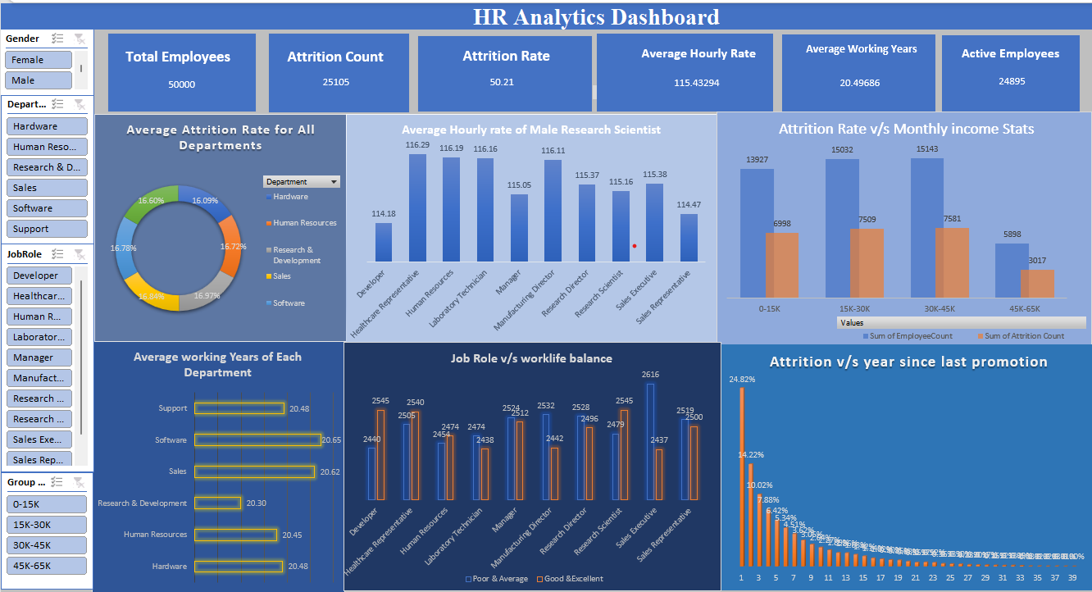
Excel Interactive Dashboard

Slide 7
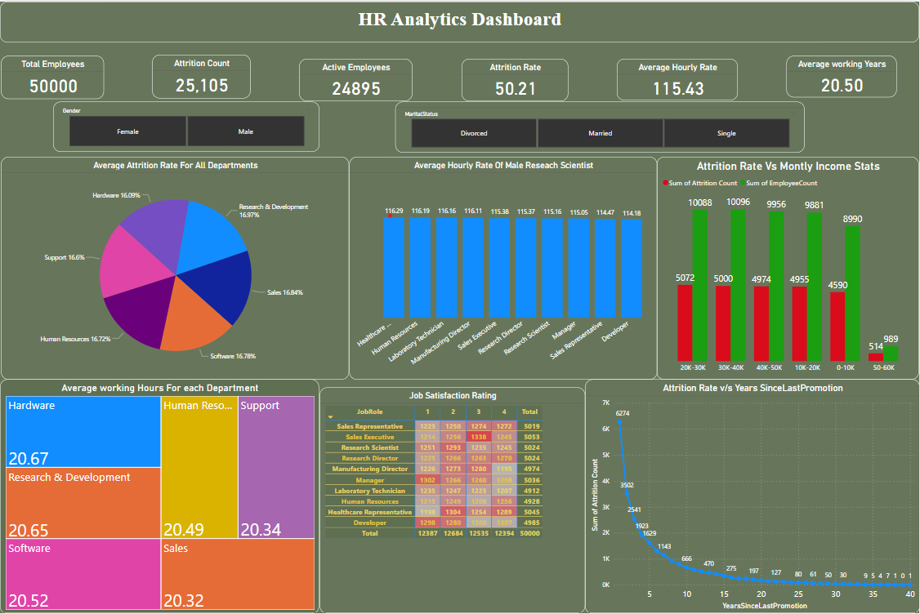
Power Bi Interactive Dashboard

Slide 8
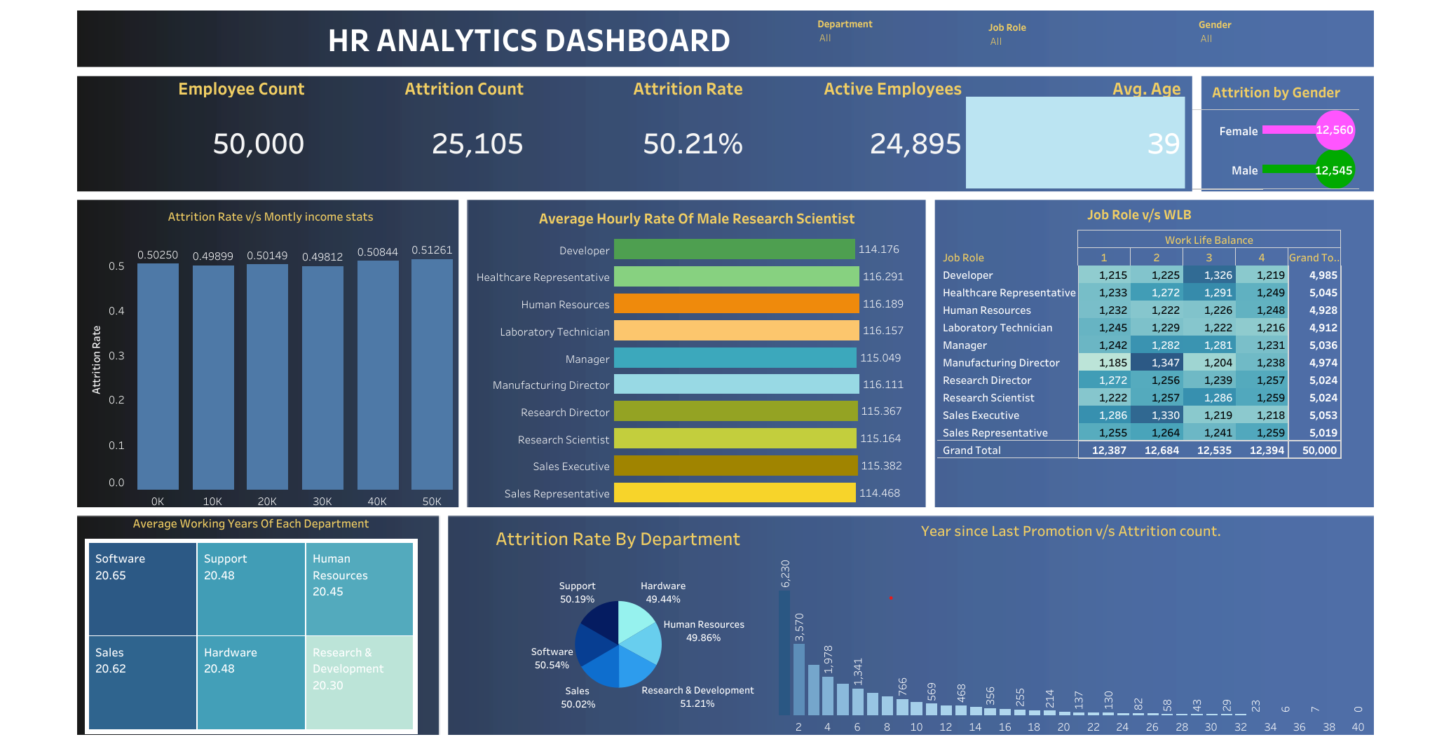
Tableau Interactive Dashboard

Slide 9
Factors affecting attrition in company
Job Satisfaction
Work-Life Balance
Compensation and Benefits
Recognition and Appreciation
Workplace Environment
Career Development Opportunities
Organizational Culture

Slide 10
Job Role vs Attrition count, Job Satisfaction, Worklifebalance
Interpretation:
It is observed that Job satisfaction and work life balance is poor & Average for Sales Executive Job role that is the reason for increased Attrition count for sales executive Job role.
It is Observed that Attrition count for Research Scientist Job role is very less as WLB and Job satisfaction is Good &Excellent.

Slide 11
Attrition count observed in Job Role for Groupwise salary
It is observed that the higher the salary the less the attrition count

Slide 12
Job Role vs Attrition count, Performance Rating
Interpretation is that Performance Rating is Poor &Average for Healthcare Representative and sales Representative which is directly influencing attrition count.

Slide 13
Environment Satisfaction V/S Job Role
Interpretation - The environment Satisfaction is Maximum Poor & Average for Sales Representative , Manager, Human Resource , Developer job Role.
Which is impacting the increased attrition count for respective job roles.

Slide 14
Job Involvement v/s Job Role
Job Involvement is one the aspect for increase in attrition count for different job roles.
Poor & Average involvement in Job role is leading to increase in attrition count for respective job roles.

Slide 15
Any Questions??

Slide 16
Thank You

